Slide 1
Fingerprinting based Localization with LoRa using Deep Learning Techniques
Presented By:
Jait Nitinkumar Purohit
Masters of Science, Computer Science
Date: 11/01/2019
Guidance By:
First Reader: Dr. Xuyu Wang
Second Reader: Dr. Xiaoyan Sun
Department of Computer Science,
California State University, Sacramento

Slide 2
Agenda
Goal
What is Fingerprinting Localization?
Challenges in indoor and outdoor localization
Why LoRa as our communication technology?
Outdoor Localization improvements using DL models
Interpolation techniques
Comparison of DL models with pre-defined KNN solution
Other Results
Indoor Localization using Deep Learning techniques
Approach and Results
Future Work
References & Links
Q&A

Slide 3
Motivation/Goal
To identify fingerprinting mean location error of lora sensor nodes in tandem with lora gateways in a non-linear indoor and outdoor environments, and improvements using deep-learning techniques.
- All registered logos are trademark of registered organizations

Slide 4
What is Fingerprinting Localization?
GPS is very important in various localization applications
Indoor: Building Infrastructure positioning
Outdoor: Car Navigation, Cell-phones tracking, Edge-to-Edge apps
Localization techniques:
Range-based techniques
Range-free techniques
Fingerprinting

Slide 5
What is Fingerprinting Localization?
Range-based techniques – focuses on distance (angle) between end-nodes to estimate location
Range-free techniques – focuses on target object’s proximity to send beacons with known locations
Fingerprinting – Mapping technique used in indoor and outdoor positioning applications. It operates in short-range RF propagation pattern and is used to address problems with multi-path
Notes:
Range-based techniques : Approaches: Proximity, Lateration, Hyperbolic Lateration, Angulation
Range-Free techniques : Beacons are the wireless transmitters used to send signals to other devices, for making location based searching and interaction more easier and more accurate

Slide 6
Challenges in indoor and outdoor localization
Non-linear relation between sensor nodes and target base-stations
Power consumption and Cost challenges
Typical infrastructure layouts in indoor environments
Co-existence with wireless systems
RSSI signal instability due to line-of-sight and non-line-of sight problems
Spatial Ambiguity – Similar fingerprints for distant locations and current location

Slide 7
Why LoRa as our communication technology?
LoRa stands for Long Range, is a DNA for IoT
LoRa is a spread spectrum modulation technique based on CSS (Chirp Spread Spectrum) technology
Millions of sensor devices are inter-connected using LoRa
Lora Node sends data over internet to Lora Gateway
Gateway sends data to Cloud for further processing using machine learning and artificial intelligence
- All registered logos are trademark of registered organizations

Slide 8
Why LoRa as our communication technology?
High Indoor and Outdoor accuracy in fingerprinting methods
Stability of RSSI values in comparisons to BLE and WiFi
Outperforms BLE and Wifi in terms of Packet-Drop in all line-of-sight and non-line-of-sight scenarios
LoRa shows higher logarithmic relation with distance in Path Loss comparison with BLE and WiFi

Slide 9
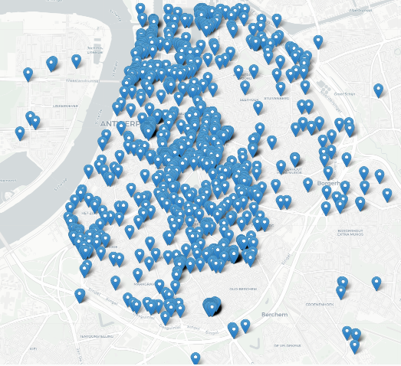
Outdoor Localization improvements using Deep Learning Models
Publicly available LoRaWAN dataset from Antwerp, Belgium https://zenodo.org/record/1212478#.XaOhXJNKii5
Goal: Create Benchmark to evaluate fingerprinting localization algorithms in outdoor environments
123,529 LoRawan messages from several nodes were sent to LoRa base-stations
K-Nearest Neighbor Algorithm : 398.4 [m] mean location error
Our Approach: Improved Results using Deep Learning Models

Slide 10
Outdoor Localization: Interpolation Techniques
Outliers like -200 values in the raw-data
Idea is to corrupt some of outlier values to 0 and reconstruct/denoise them using autoencoders
Outliers
Next Step: Split Training and Test Data
Notes:
Other Interpolation Techniques: Linear, Cubic, Quadratic

Slide 11
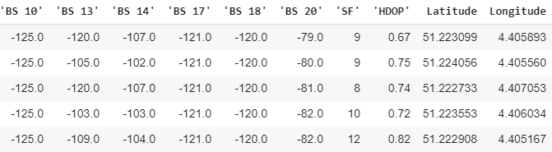
Outdoor Localization: Split Train-Test Data
After Interpolation, split data-frame into 70% training and 30% test data
Next Step: Apply Deep Learning Models
Notes:
Other Interpolation Techniques: Linear, Cubic, Quadratic

Slide 12
Outdoor Localization: How we calculate mean location error [m]
Location Error [m]
= [(x₂ - x₁)² + (y₂ - y₁)²]^{1/2}
Mean Location Error [m]
= [(x₂ - x₁)² + (y₂ - y₁)²] ^{1/2}
n

Slide 13
Outdoor Localization: Results

Slide 14
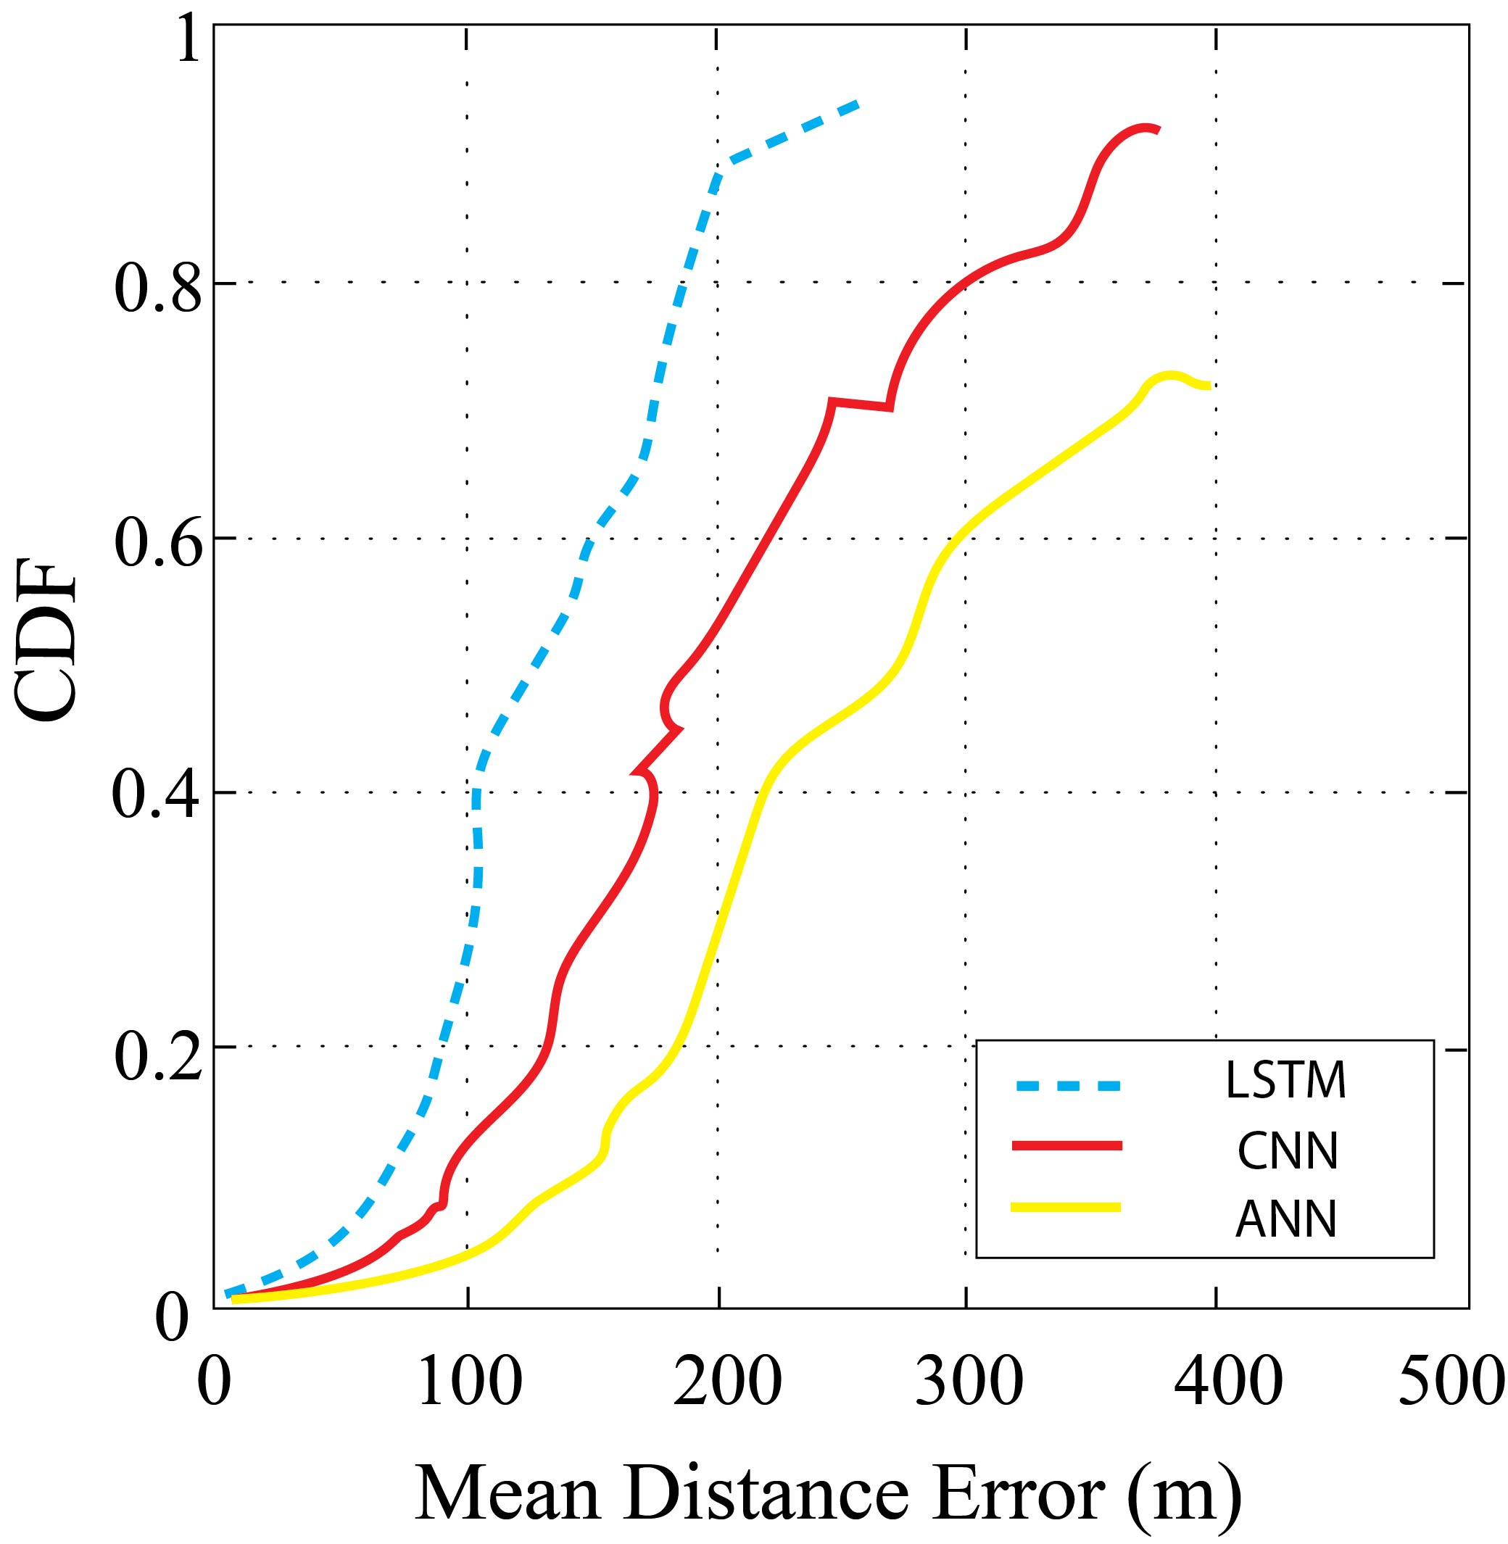
Outdoor Localization: Results

Slide 15
Outdoor Localization: Impact of Design Parameters

Slide 16
Indoor Localization: Step 1 Offline Stage
RVR 3rd Floor is virtually divided into
(x,y) co-ordinate system
RSSI data collection for two base-stations
from same lora node at different
locations known as fingerprints
- All registered logos are trademark of registered organizations

Slide 17
Indoor Localization : Step 2 Online Stage
Fingerprint (RSSi1, RSSi2, ….)
Unknown Location
+
Data Pre-processing
LSTM, ANN, CNN
Hyperparameter Tuning
Estimate Mean Location Error
- All registered logos are trademark of registered organizations

Slide 18
Indoor Localization : Architecture
- All registered logos are trademark of registered organizations

Slide 19
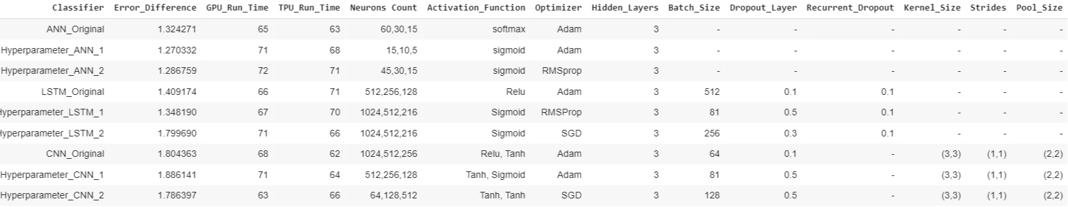
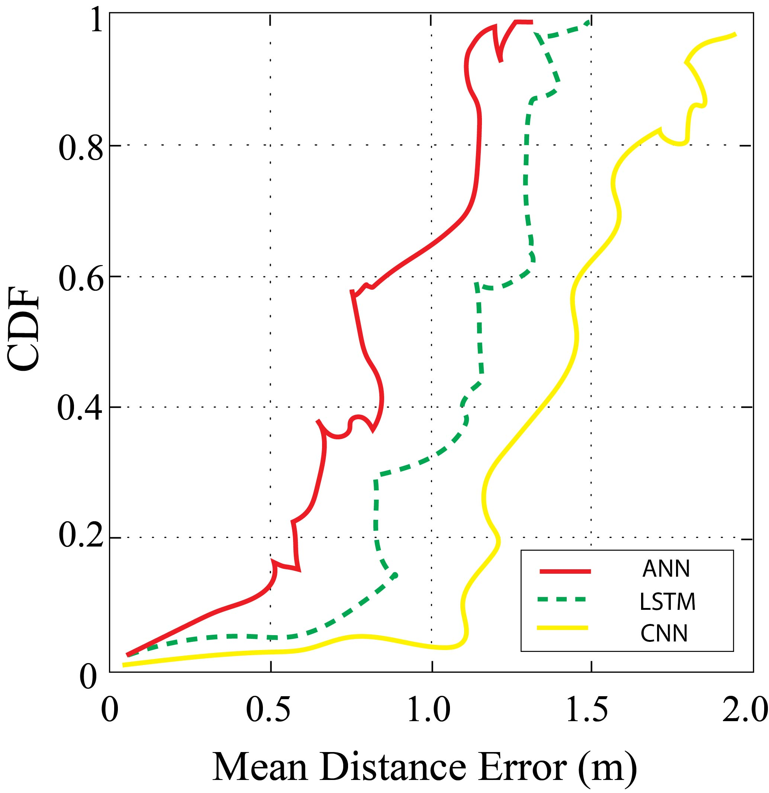
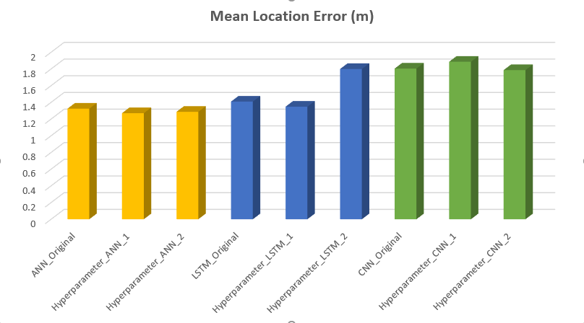
Indoor Localization: Results

Slide 20
Deep Learning: LSTM Architecture
- All registered logos are trademark of registered organizations

Slide 21
Deep Learning: Choosing right LSTM Hyperparameters
Number of hidden-layer neurons
Ni = Input Neurons, No = Output Neurons
Ns = Training Samples, α = Scaling Factor (2-10)
Dropout layer – to prevent from overfitting
Activation/Transfer function – sigmoid, relu, tanh, softmax
Optimizers – adam, rmsprop, sgd
Batch-Size – 64, 81, 128, 256, 512
GPU vs TPU training accuracy
- All registered logos are trademark of registered organizations

Slide 22
Outdoor Localization: Impact of Design Parameters

Slide 23
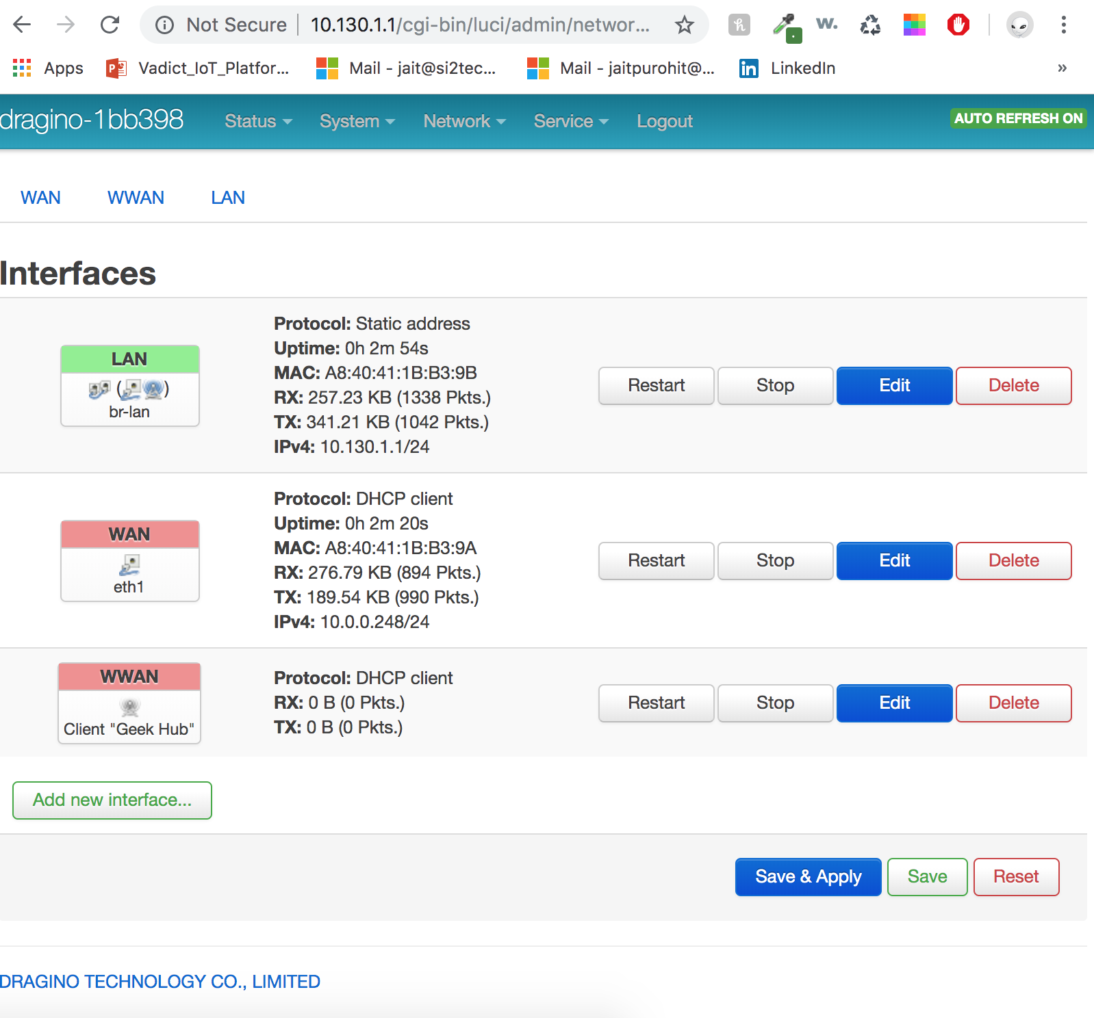
Indoor Localization: Setup Dragino LoRa gateway

Slide 24
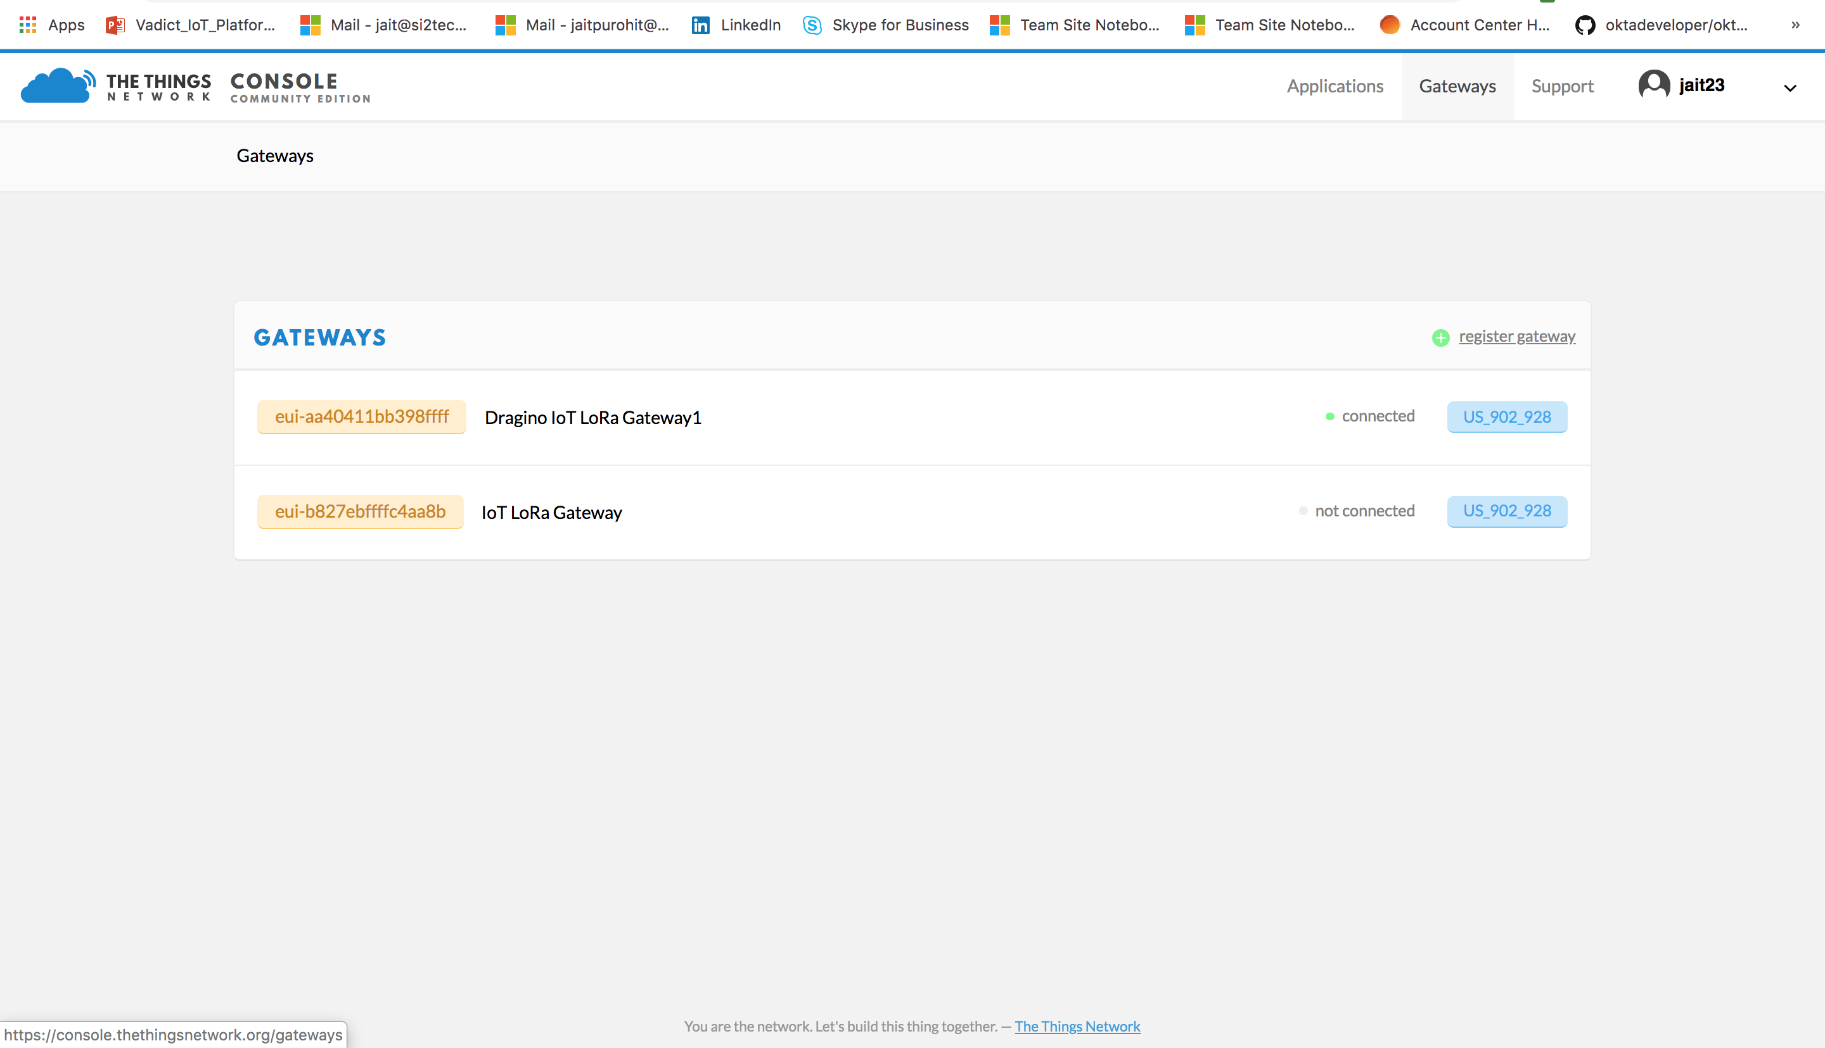
Indoor Localization: Register Gateway on The Things Network Cloud

Slide 25
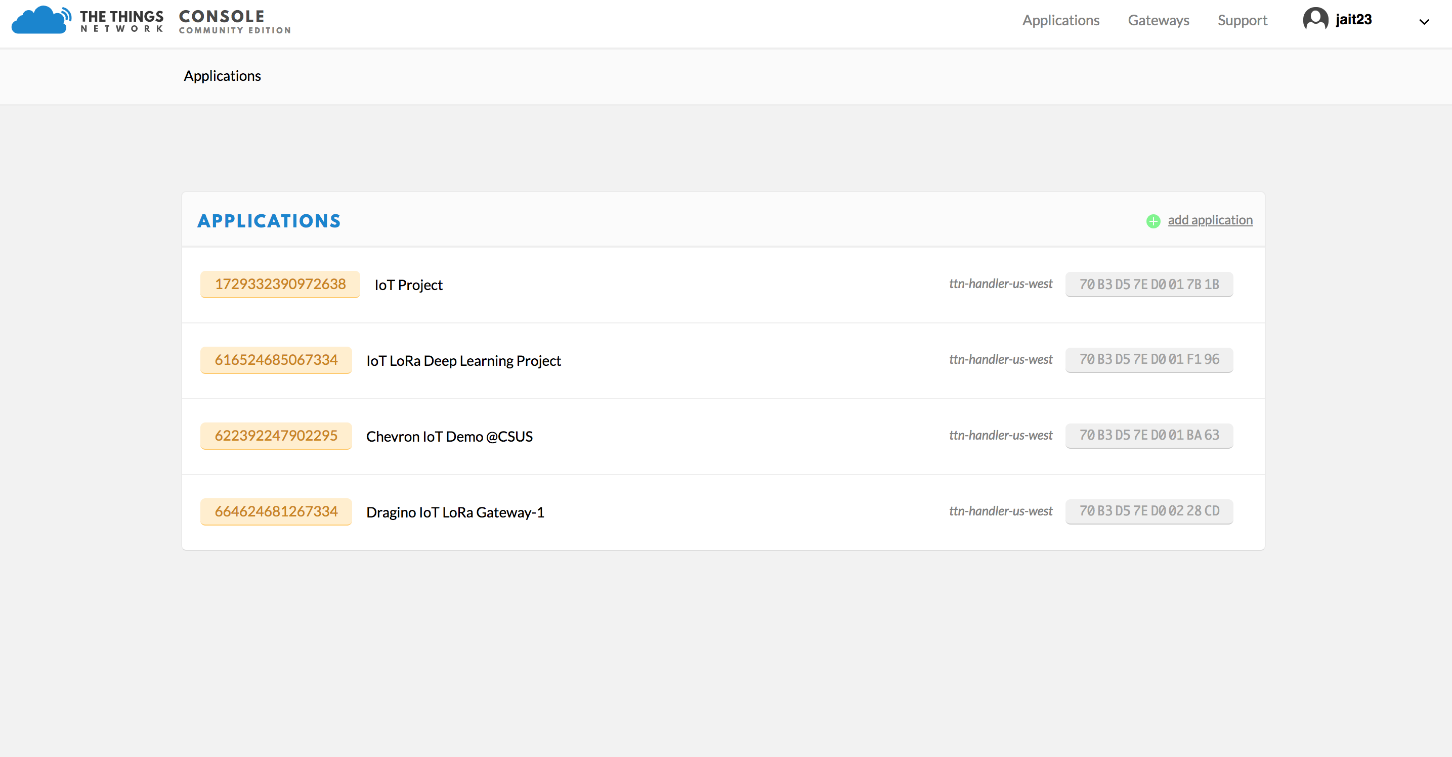
Indoor Localization: Create Application on TTN

Slide 26
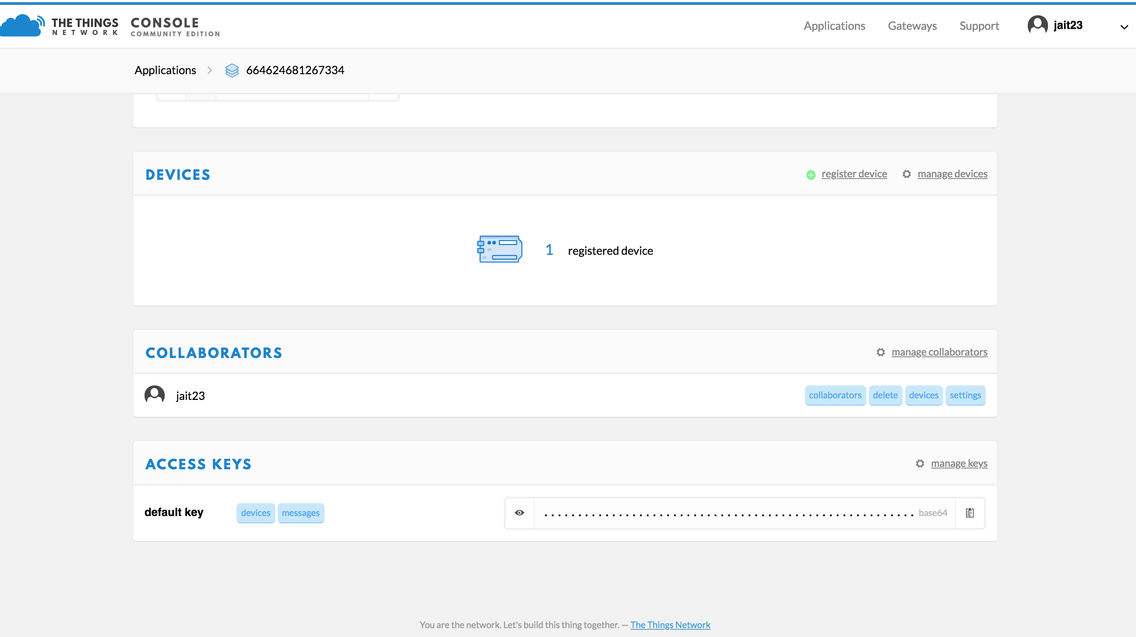
Indoor Localization: Setup LoRa Node with Arduino and register Device on TTN

Slide 27
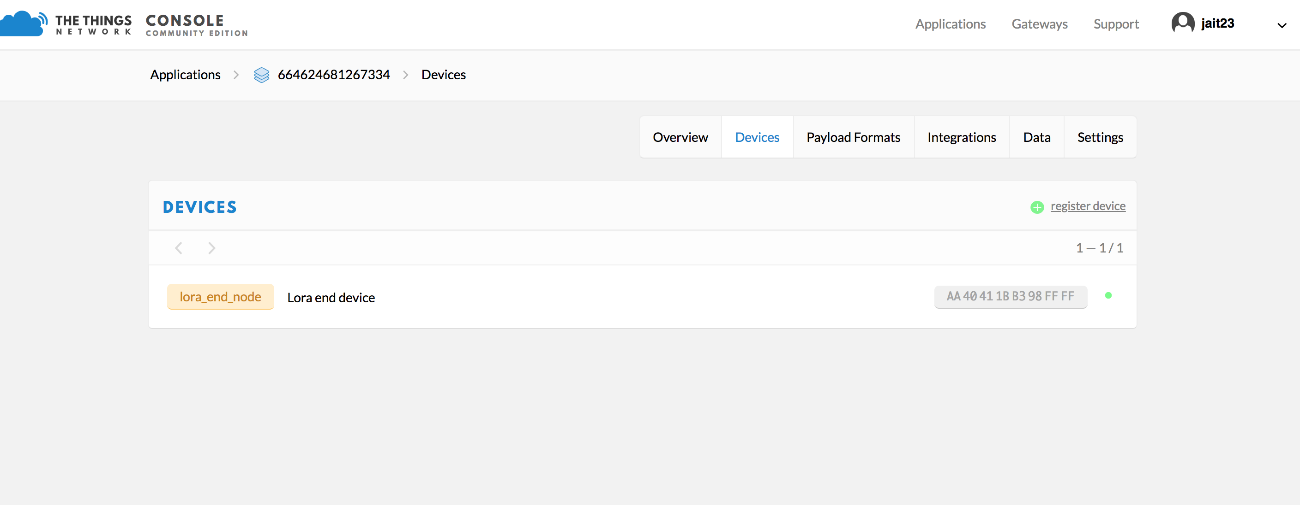
Indoor Localization: Setup LoRa Node with Arduino to send data to gateway

Slide 28
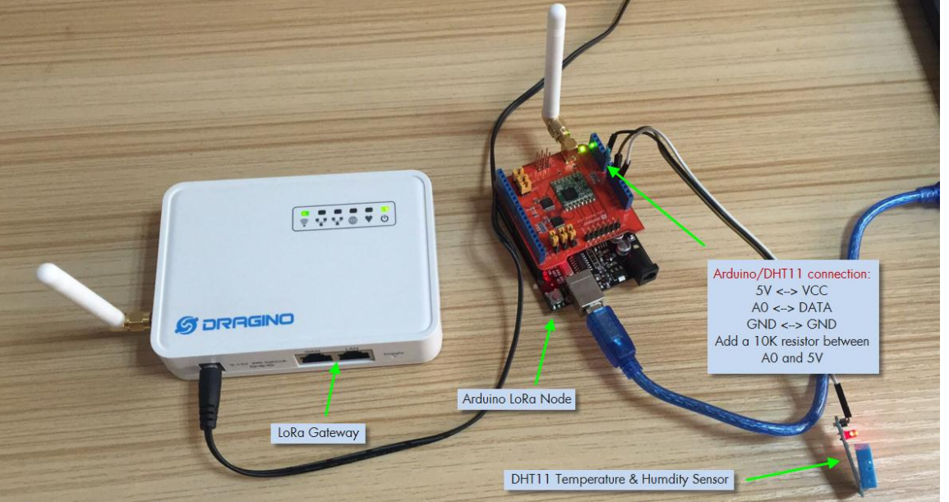
Indoor Localization: Setup LoRa Node with Arduino to send data to gateway
- All registered logos are trademark of registered organizations

Slide 29
Indoor Localization: Monitor Gateway Traffic on TTN

Slide 30
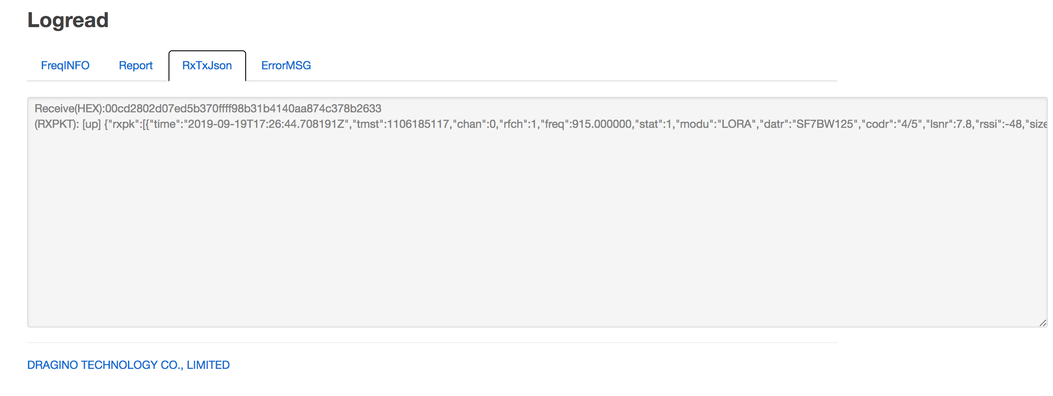
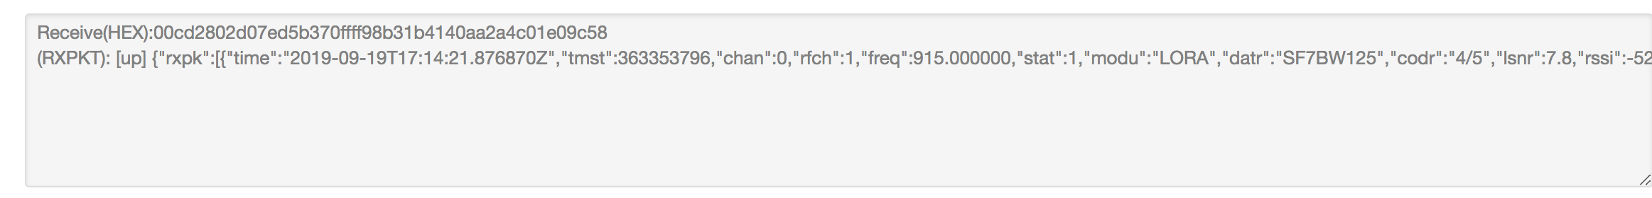
Indoor Localization: Monitor Gateway Traffic on gateway logs

Slide 31
Coding Languages, Frameworks, Libraries and Tools
Coding Languages: Python, C, C++
Frameworks: Google Tensorflow
Hardware Accelerators: GPU, TPU
Libraries: Scikit-Learn, Keras, Pandas, Numpy, Seaborn, Matplotlib
Tools: Google Colab, Jupyter, Ananconda, Dragino LoRa Kit
- All registered logos are trademark of registered organizations

Slide 32
Future Work
Gather more indoor data in all 4 directions, to improve accuracy and reduce problem of overfitting
Try other deep-learning models like bi-directional lstm to mitigate problems of back-propagation in RNN and LSTM
Verify results at same location, but with different sensor nodes
Use naïve bayes theorem for estimating probability of base-stations
Classification based on RSSI values can be implemented using tensor-flow
Compare our results with that of BLE and WiFi
Security Implementation of LoRaWAN in indoor localization

Slide 33
References & Links
Recurrent Neural Networks For Accurate RSSI Indoor Localization [Online]: https://arxiv.org/pdf/1903.11703.pdf
Sigfox and LoRaWAN Datasets for Fingerprint Localization in Large Urban and Rural Areas [Outdoor Dataset]: https://www.mdpi.com/2306-5729/3/2/13
DeepML: Deep LSTM for Indoor Localization with Smartphone Magnetic and Light Sensors [Online]: https://ieeexplore.ieee.org/abstract/document/8422562
Deep Convolutional Neural Networks for Indoor Localization with CSI Images: [Online]: https://ieeexplore.ieee.org/document/8468057
Dragino LoRa Implementation Guide [Online]: http://www.dragino.com/downloads/downloads/LoRa_IoT_Kit/v2-Kit/Single%20Channel%20LoRa%20IoT%20Kit%20v2%20User%20Manual_v1.0.5.pdf
LSTM using Tensorflow [Online]: https://towardsdatascience.com/lstm-by-example-using-tensorflow-feb0c1968537
Denoising Autoencoders [Online]: https://towardsdatascience.com/denoising-autoencoders-explained-dbb82467fc2

Slide 34
Questions?

Slide 35
Thank you

